Slide 1



Internal

Slide 2
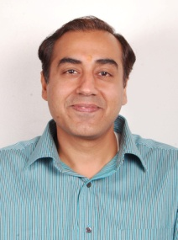
Greetings,
On your first day, I take this opportunity to be among the first to welcome you into Ugam. In a dynamic and fast growing organization like ours, the IT team finds itself in a privileged position to be your trusted and supportive partner in every step. We understand that technology plays a key role in Ugam’s and your success and hence we aim in delivering and being the facilitating force behind Ugam victories. Through the innovative use of existing and emerging technologies and with their support we seek to create and deliver platforms from which Ugam and you can achieve new heights.
Wish you the very best in the new and exciting journey you are to undertake with us in Ugam.
Vishal Katial
Head – IT, ISMS & ERM
Internal

Slide 3






On your First Day
In order to fulfill all your IT needs you have been provided with a Computing Device
An Unique System ID has been created for you to access the System and the Virtual resources in a secured manner
You have also been provided with an Distinct Email ID which will enable you to Communicate with colleagues and Clients
Based on your Job role you have been provided with Secure High Speed Internet access to facilitate your business
A Robust Telecom Infrastructure is for your use to reach Colleagues and Clients faster
You will also receive Prompt Assistance from the IT team regarding any IT issues you encounter.
Internal

Slide 4

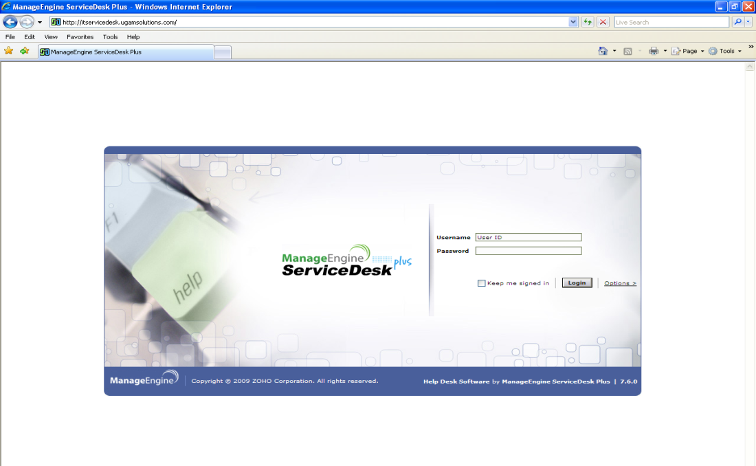

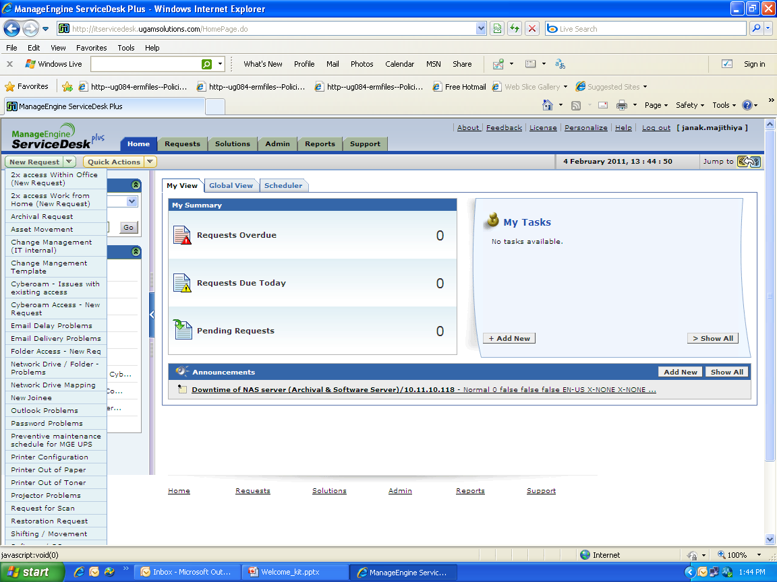
IT-Service Desk
    IT – Service Desk is a one stop in house IT portal for all your requests.
You can access it using your browser. Its always found in Favorites -> Ugam -> IT Service desk.
You can also access the site from the below link, http://itservicedesk.ugamsolutions.com/. Go ahead visit the page.
You can login into service-desk using your domain ID and Password.
    Also provided at hand are easy to use Request Templates
    These templates are located in the top right of your browser window.
    These templates enable you to easily raise requests for a large number of IT issues you would face.
    Once you raise a request an IT Engineer would be assigned to provide a resolutions within a suitable timeline.
Internal

Slide 5

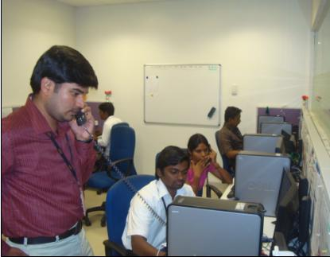

Contact Sys-team
For IT Support please dial Global Service Desk number
1111
Kindly follow up the IVR options based on your requirements
Goregoan (GW) : +91 22 6652 7300
Thane (TH) : +91 22 6652 7300
Coimbatore (CJB) : +91 422 664 8400
Our Team of dedicated and qualified engineers are available
round the clock to provide you with
24x7 problem resolution support for any IT related issues that you may face.
You can also reach us by Mail on ithelpdesk@ugamsolutions.com
Internal

Slide 6
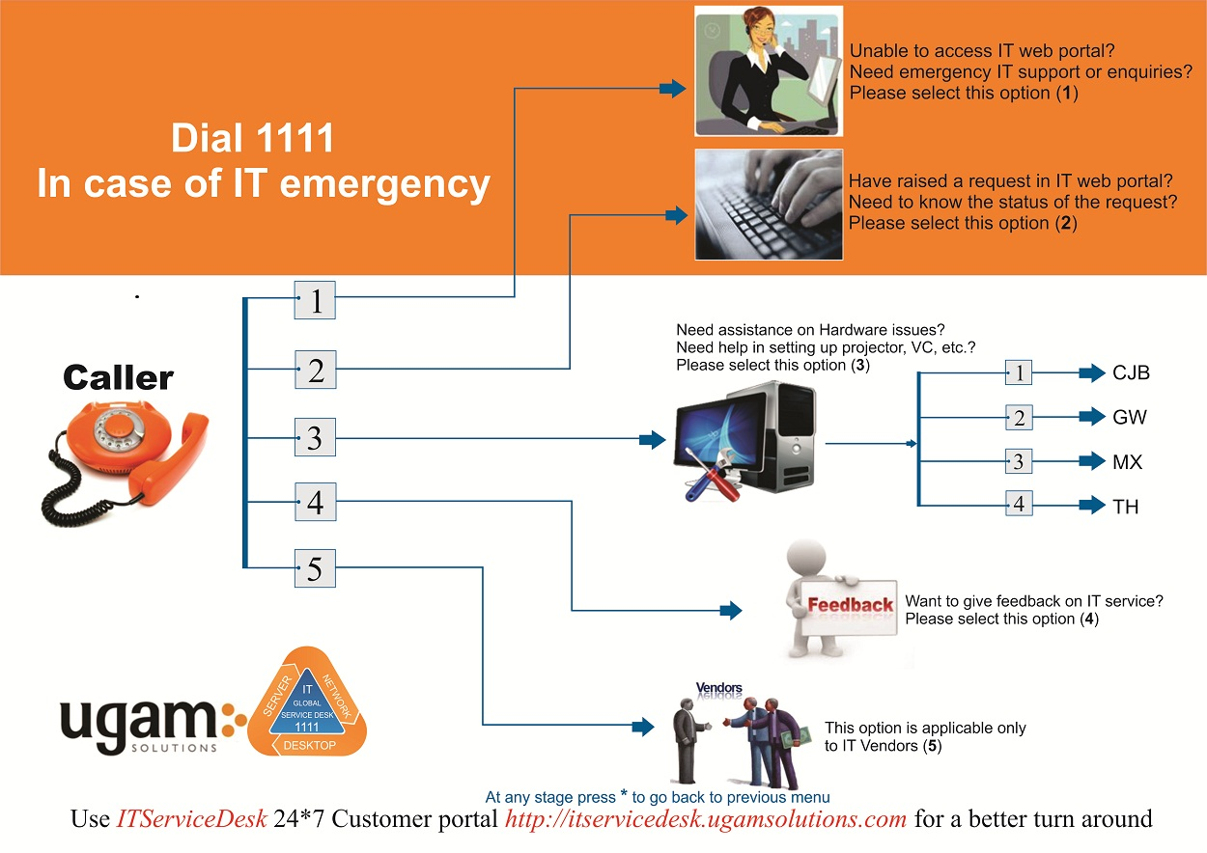
Know more about IVR Options

Slide 7




Know your Sys-Team
The Sys-Team in Ugam is responsible for managing all of Ugam’s IT infrastructure across various locations. The Sys-team consists of:-
The Service desk team:
A centralized team to support and track all the IT related issues that you would encounter.
The Desktop Team:
Local desktop team’s are present in all locations to assist and provide you with quick resolutions to any local desktop issues you may face.
The Server Team:
The Server team is responsible for managing the various shared infrastructure (e.g. Mail, Infrastructure servers etc) used within Ugam.
The Network and Telecom Team:
The Network and Telecom team administers the internal network, Internet links and telecom infrastructure.
Internal

Slide 8

Acceptable Usage Guideline
The use of resources provided to you has to be managed well for it to bring the maximum benefit for the organization and for you. Hence we would like you to treat these facilities with respect and accept and follow the guidelines of acceptable usage.
A few of the guidelines are mentioned below.
Be aware of various policies and processes governing usage of equipment.
You must not engage in any inappropriate use of the equipment.
Do not circumvent any control put in place to protect the privacy and integrity of systems.
User’s are responsible for the well being of equipment allotted to them.
If you face any issues do not hesitate in seeking IT support.
You can find the complete set of guidelines on the ERM.
Internal

Slide 9



Green Ugam
IT has always been taking the lead in the Green and environment friendly initiatives within Ugam. IT has constantly encouraged and embraced Green Technology and Practices. A few Green tips that one can follow are
Print only if absolutely necessary. Kindly print in Draft mode, Use duplex printing whenever possible and recycle printouts.
Shut down your machine when you leave for the day, thus saving on the power consumption
Internal

Slide 10
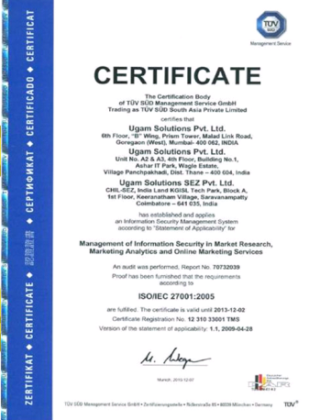


ISMS @ Ugam
Information Security is taken very seriously at Ugam.
Ugam is certified with the prestigious
ISO/IEC 27001:2005 certification.
At Ugam we are committed with security of information related to our Clients, Stakeholders, and employees. We have put in place an organization wide Policies and procedure which guide user’s to safeguard against a variety of threats and events.
All the ISMS policies and procedures can be found in HRIS. You can also reach the ISMS team by mailing to iso@ugamsolutions.com
Internal

Slide 11

ISMS @ Ugam
To Keep Ugam Safe and Secure from a large number of threats, the ISMS team conducts Audits, Monitoring and Surveillance activities on E-Mails, Internet Usage and other services. With these efforts and User support Ugam has been successfully fulfilling the ISO 27001 standard requirements.
A few basic Guidelines within the ISMS one needs to follow are
Be aware of various ISMS policies, guidelines and procedures.
Do Know your Team’s ISIT, approach your ISIT or the ISMS team regarding any queries.
Do not share your password with others.
Do not Disclose sensitive information.
Report any suspicious activities to incidents@ugamsolutions.com
Always wear your ID card prominently.
Do not leave your computing device unlocked when unattended(Always use Ctrl + Alt + Del + Enter)
Do not save business related data on your desktop (Follow Clear screen and clear desk practices).
Do not share official email id for non business purpose.
Internal

Slide 12

Internal

